Slide 1

Research Methodology
Introduction to Research
Dr. Arti Arya
Department of Computer Science and Engineering

Slide 2

Research Methodology
Introduction to Research
(UE19CS400SA)
Dr. Arti Arya
Department of Computer Science and Engineering

Slide 3
Research Methodology
Disclaimer
The content of these slides is prepared from the prescribed text book and other reliable resources from the Internet.

Slide 4
Research Methodology
Syllabus and Content

Slide 5

Research Methodology
Meaning of Research
Research is creative and systematic work undertaken to increase the stock of knowledge.
So basically Search of knowledge.
It involves the collection, organization and analysis of information to increase understanding of a topic or issue.
Scientific and systematic search for pertinent information on a specific topic.

Slide 6
Research Methodology
Meaning of Research
Art of Scientific Investigation.
A careful investigation or inquiry specially through search for new facts in any branch of knowledge.
A research project may be an expansion on past work in the field.
To test the validity of instruments, procedures, or experiments, research may replicate elements of prior projects or the project as a whole.

Slide 7

Research Methodology
Meaning
Redman and Mory “ Systematic effort to gain new knowledge.”
Clifford Woody says
Defining and redefining problems,
formulating hypothesis,
collecting,
organizing and evaluating data,
making deductions and reaching conclusions”
Courtesy: https://gifer.com/en/3QCY

Slide 8

Research Methodology
Meaning

Slide 9

Research Methodology
Objectives of Research
To gain new insights into a phenomenon.( studies with this objective are termed as exploratory or formulative research studies)
To portray accurately the characteristics of a particular situation, person or a group.( studies with this objective are descriptive research)

Slide 10
Research Methodology
Objectives of Research
To determine the frequency with which something occurs.( diagnostic research).
To test a hypothesis of a causal relationship between variables( hypothesis testing research)

Slide 11

Research Methodology
Motivation
Why do you want to do Research?
Desire to get a research degree along with its consequential benefits
Repository of Indian Thesis:
https://shodhganga.inflibnet.ac.in/
2. https://etd.iisc.ac.in/

Slide 12
Research Methodology
Motivation
Why do you want to do Research?
Desire to face challenge in solving the unsolved problems

Slide 13
Research Methodology
Motivation
Why do you want to do Research?
Desire to get intellectual joy of doing some creative work.

Slide 14
Research Methodology
Motivation
Why do you want to do Research?
Service to society

Slide 15
Research Methodology
Motivation
Why do you want to do Research?
To get respect

Slide 16
Research Methodology
Types of Research
Descriptive vs Analytical
Applied vs Fundamental
Quantitative vs Qualitative
Conceptual vs Empirical

Slide 17
Research Methodology
Types of Research
Descriptive vs. Analytical
Surveys and fact finding enquiries
Major purpose of descriptive research is description of the state of affairs as it exists at present (Ex post facto Research in Social Sciences and Business )
Main Characteristic: The researcher has no control over the variables- he can only report what has happened, or what is happening;
e.g.: frequency of shopping, preferences of people
Methods used for such research: Comparative and correlation.
In analytical research, the researcher has to use facts or information already available and analyze these to make a critical evaluation of the material
In Analytical research, facts or information already available is used.
Researcher analyzes this info/facts and prepare a critical evaluation.

Slide 18

Research Methodology
Types of Research
2. Applied vs Fundamental
The research can either be applied (or action) research or fundamental (or basic or pure) research
Applied vs Fundamental
Aims at finding a solution for an immediate problem facing a society or an industrial business organization.
Market research, design, safety, health, pollution, societal, environmental, industrial, pharmaceutical etc.
Mainly concerned with generalizations and with the formulation of a theory.
e.g. pure mathematics, theoretical physics, generalization of human behavior.

Slide 19

Research Methodology
Types of Research
3. Quantitative vs Qualitative
Based on the measurement of quantity or amount
Controlled, rather easy to carryout
Objective and repeatable
Easy to draw conclusions and decisions
Concerned with qualitative
phenomenon, i.e., involving quality
or kind
Eg. To discover the underlying motives of human behavior;
Attitude or opinion research (how people feel
or think about a particular subject or institution)
difficult job; should seek guidance from
experimental psychologists.

Slide 20

Research Methodology
Types of Research
4. Conceptual vs Empirical
Conceptual vs Empirical
Related to some abstract idea(s) or theory; generally used by philosophers and thinkers to-develop new concepts or to re-interpret existing ones
Relies on experience or observation alone, without due regard for system and theory. It is data-based research, coming up with conclusions which are capable of being verified by observation or experiment.
Characterized by the experimenter’s control over the variable s under study and his deliberate manipulation of one of them to study its effects.
Evidence gathered through experiments or empirical studies is today considered to be the most powerful support possible for a given hypothesis

Slide 21

Research Methodology
Types of Research
5. Some Other Types
Field –Setting Research
Lab Research
Simulation Research
Clinical/Diagnostic Research
Historical Research etc…..
depending on the environment
Find the difference between Research Method and Research Methodology

Slide 22
Research Methodology
Research Process
Step 1: Ask Meaningful Question or Identify significant problem
Step 4: Test hypothesis to allow confirmation and validity
Step 2: Attempt to answer question or Pose solution to problem
Modify
Step 5: Accept, modify or reject hypothesis
Step 3: Answer to question as a Scientific hypothesis or Proposed solution to problem
Reject
Accept
Step 6: Construct, support, or cast doubt on a scientific theory

Slide 23
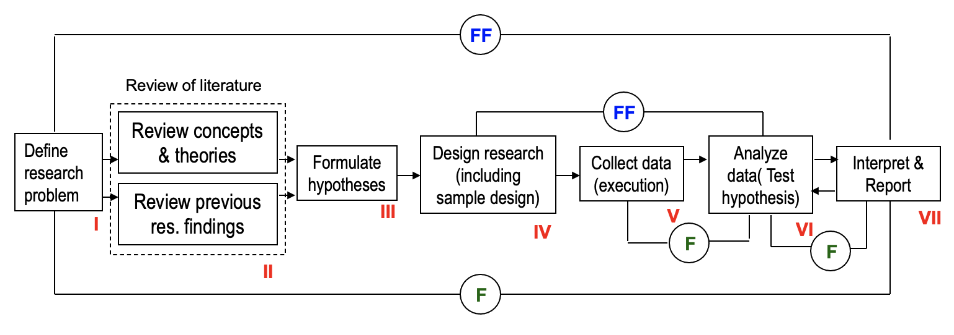
Research Methodology
Research Process
F
= feed back (Helps in controlling the sub-system to which it is transmitted
FF
= feed forward (Serves the vital function of providing criteria for evaluation

Slide 24
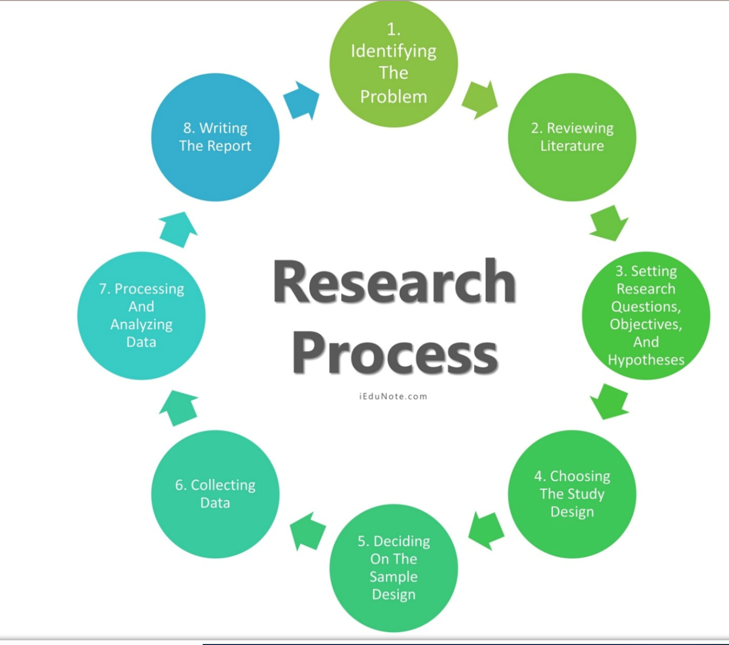
Research Methodology
Research Process
https://www.iedunote.com/research-process

Slide 25
Research Methodology
Research Process
RESEARCH PROCESS: Series of steps, closely related activities, not mutually exclusive, necessary to effectively carry out research.
The order concerning various steps provides a useful
procedural guideline regarding the research process:
Formulating the research problem;
Extensive literature survey;
Developing the hypothesis;
Preparing the research design;
Determining sample design;
Collecting the data;
Execution of the project;
Analysis of data;
Hypothesis testing;
Generalizations and interpretation, and
Preparation of the report or presentation of the results, i.e., format write-up of conclusions reached.

Slide 26
THANK YOU
Dr. Arti Arya
artiarya@pes.edu

